Slide 1
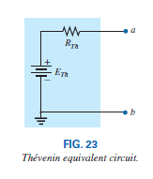
College of Engineering Dept. of the electrical power and Machine engineering
Subject / Electrical Eng. Fundamental I
THÉVENIN’S THEOREM
In general, the theorem can be used to do the following:
Analyze networks with sources that are not in series or parallel.
stage / first Date: 20/12/2017 Lecture:9
Time/ 2 hours
Reduce the number of components required to establish the same characteristics at the output terminals
Investigate the effect of changing a particular component on the behavior of a network without having to analyze the entire network after each change..
Thévenin’s theorem states the following:
Any two-terminal dc network can be replaced by an equivalent circuit consisting solely of a voltage source and a series resistor as shown in Fig. 23.
Thévenin’s Theorem Procedure Preliminary:
Remove that portion of the network where the Thévenin equivalent circuit is found. In Fig. 25(a), this requires that the load resistor RL be temporarily removed from the network.
Mark the terminals of the remaining two-terminal network. (The importance of this step will become obvious as we progress through some complex networks.)
RTh:
Calculate RTh by first setting all sources to zero (voltage sources are replaced by short circuits and current sources by open circuits) and then finding the resultant resistance between the two marked terminals. (If the internal resistance of the voltage and/or current sources is included in the original
network, it must remain when the sources are set to zero.) ETh:
Calculate ETh by first returning all sources to their original position and finding the open-circuit voltage between the marked terminals. (This step is invariably the one that causes most confusion
and errors. In all cases, keep in mind that it is the open circuit potential between the two terminals marked in step 2.)
Conclusion:
Draw the Thévenin equivalent circuit with the portion of the circuit previously removed replaced
between the terminals of the equivalent circuit. This step is indicated by the placement of the resistor RL between the terminals of the Thévenin equivalent circuit as shown in Fig. 25(b).

Slide 2
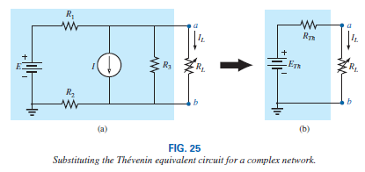
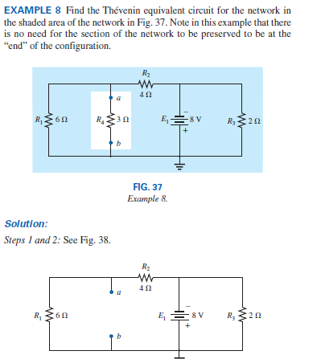
College of Engineering Dept. of the electrical power and Machine engineering
Subject / Electrical Eng. Fundamental I
stage / first Date: 20/12/2017 Lecture:9
Time/ 2 hours

Slide 3
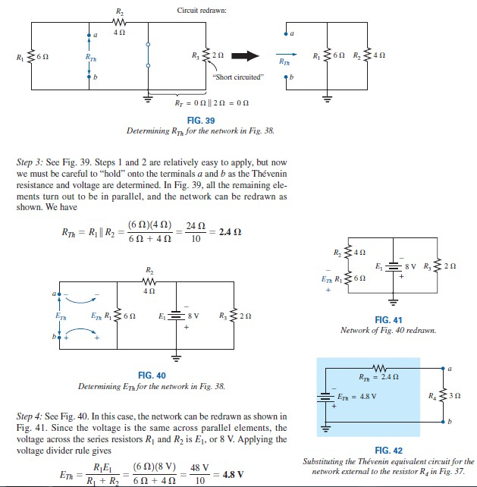
College of Engineering Dept. of the electrical power and Machine engineering
Subject / Electrical Eng. Fundamental I
stage / first Date: 20/12/2017 Lecture:9
Time/ 2 hours

